Slide 1
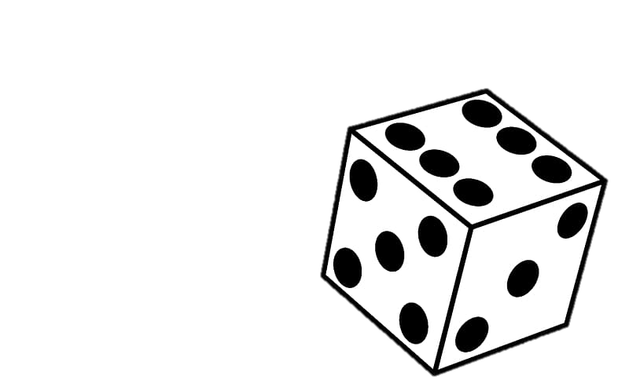
Duel of dices
A competitive guessing game that relies on luck
https://github.com/ksu-is/Duel-of-Dices
By: Ebonee Ward

